Slide 1
Hierarchical Tag visualization and application for tag recommendations
CIKM’11
Advisor：Jia Ling, Koh
Speaker：SHENG HONG, CHUNG

Slide 2
Outline
Introduction
Approach
  Global tag ranking
    Information-theoretic tag ranking
    Learning-to-rank based tag ranking
  Constructing tag hierarchy
    Tree initialization
    Iterative tag insertion
    Optimal position selection
Applications to tag recommendation
Experiment

Slide 3


Introduction
Blog
tag
tag
tag

Slide 4

Introduction
Tag: user-given classification, similar to keyword
Volcano
Cloud
sunset
landscape
Spain
Ocean
Mountain

Slide 5

Introduction
Tag visualization
  Tag cloud
Tag cloud
Cloud
Volcano
landscape
Cloud
landscape
Spain
sunset
Spain
Ocean
Mountain
Mountain
Notes:
那Tag cloud又是什麼呢？「標籤雲」是指許多Tag排列時，當Tag被使用程度越高、連結越多時，字體會變大且
顏色也會更顯眼，許多Tag的集合就好比雲朵的聚集，每個標籤都是一朵雲，雲朵會越聚越多，並依出現數呈現
大小錯置的排列。
另一種是"TagCloud"(標籤雲)，Tag Cloud將使用者所標註的tag以特定的方式排序（通常為字母順序），同時每個tag會根據被使用的頻率而有字體大小的差別，如下圖所示。目前許多Social media網站都使用了Tag Cloud，如Technorati, Flickr, del.icio.us。使用Tag Cloud的好處是輕巧簡潔，然而，這種優點卻是犧牲了一些重要的資訊而換得的，也就是它忽略了tag與tag之間隱含的關係。

Slide 6
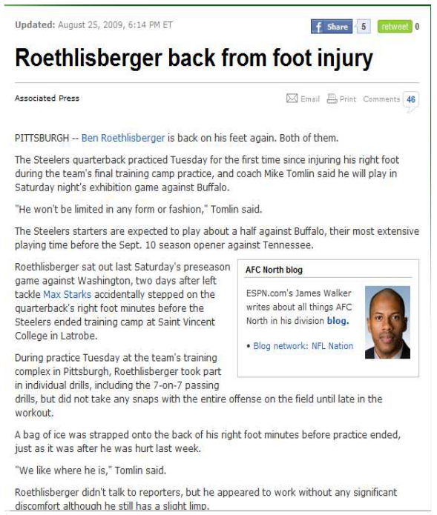
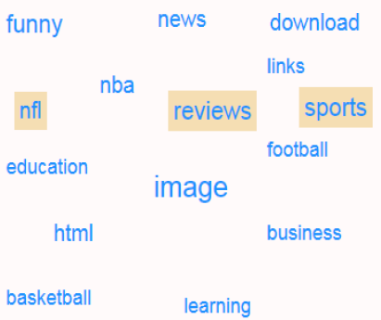
?
?
Which tags are abstractness?
Ex Programming->Java->j2ee

Slide 7
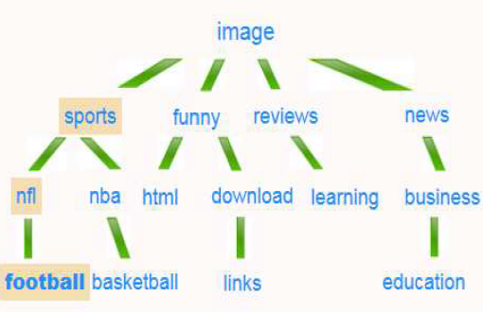

Slide 8
Approach
image
funny
learning
news
basketball
sports
funny
reviews
news
download
nfl
education
nfl
nba
html
learning
business
football
download
nba
image
html
football
education
business
links
reviews
sports
basketball
links

Slide 9
Approach
  Global tag ranking
image
Image
Sports
Funny
Reviews
News
.
.
.
.
sports
funny
reviews
news
nfl
nba
html
learning
business
download
football
education
links
basketball

Slide 10
Approach
  Global tag ranking
  Information-theoretic tag ranking I(t)
    Tag entropy H(t)
    Tag raw count C(t)
    Tag distinct count D(t)
  Learning-to-rank based tag ranking Lr(t)

Slide 11

  Information-theoretic tag ranking I(t)
Tag entropy H(t)
Tag raw count C(t)
  The total number of appearance of tag t in a speciﬁc corpus.
Tag distinct count D(t)
  The total number of documents tagged by t.

Slide 12
Define class
Most frequent tag as topic
Corpus
D₁
D₂
D₁₀₀₀₀
………..............
10000 documents
topic₁
topic₂
topic₁₀₀₀₀
Ranking top 100 as topics
A B C
Example: (top 3 as topics)
20 documents contain Tag t1
15 3 2
H(t₁) =
-( 15/20 * log(15/20) + 3/20 * log (3/20) + 2/20 * log(2/20) )
= 0.31
20 documents contain Tag t2
7 7 6
H(t₂) =
-( 7/20 * log(7/20 ) + 7/20 * log (7/20) + 6/20 * log(6/20) )
= 0.48

Slide 13
D₁
D₂
D₃
D₄
D₅
Money 12
NBA 10
Basketball 8
Player 5
PG 3
NBA 12
Basketball 9
Injury 7
Shoes 3
Judge 3
Sports 10
NBA 9
Basketball 9
Foul 5
Injury 4
Economy 9
Business 8
Salary 7
Company 6
Employee 2
Low-Paid 9
Hospital 8
Nurse 7
Doctor 7
Medicine 6
Tag raw count C(t): The total number of appearance of tag t in a speciﬁc corpus.
C(money) = 12
C(basketball) = 8 + 9 + 9 = 26
Tag distinct count D(t): The total number of documents tagged by t.
D(NBA) = 3
D(foul) = 1

Slide 14
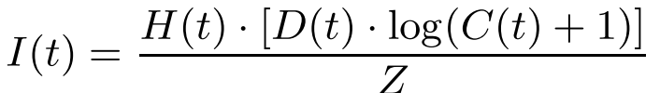


Information-theoretic tag ranking I(t)
Z : a normalization factor that ensures any I(t) to be in (0,1)
larger
larger
larger
I(fun) = $\frac{\text{H}\text{(}\text{fun}\text{) ∗ }\text{D}\text{(}\text{fun}\text{) ∗ }\text{log}\text{ (}\text{C}\text{(}\text{fun}\text{) + 1)}}{\text{Z}}$
fun
java
smaller
smaller
smaller
I(java) = $\frac{\text{H}\text{(}\text{java}\text{)}\text{ ∗ }\text{D}\text{(}\text{java}\text{)}\text{ ∗ }\text{log}\text{ (}\text{C}\text{(}\text{fun}\text{) + 1)}}{\text{Z}}$

Slide 15
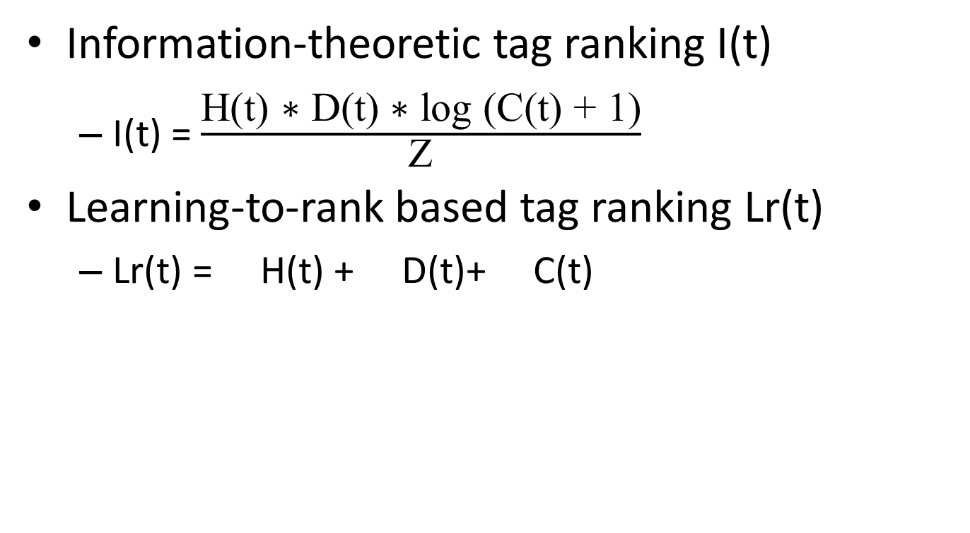
Global tag ranking
Information-theoretic tag ranking I(t)
  I(t) = $\frac{\text{H}\text{(}\text{t}\text{) ∗ }\text{D}\text{(}\text{t}\text{) ∗ }\text{log}\text{ (}\text{C}\text{(}\text{t}\text{) + 1)}}{\text{Z}}$
Learning-to-rank based tag ranking Lr(t)
  Lr(t) = H(t) + D(t)+ C(t)
w₁
w₂
w₃

Slide 16
Learning-to-rank
based tag ranking
traingingdata?
Time-consuming
automatically generate

Slide 17

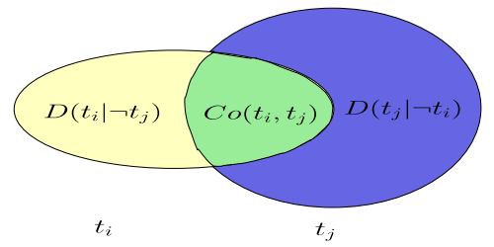

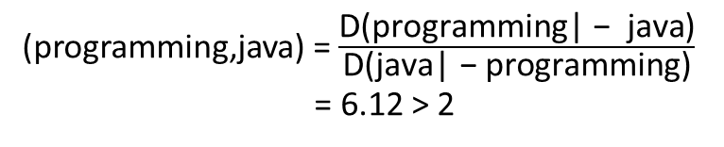
Learning-to-rank based tag ranking
D(programming| − java) = 239
Co(programming,java) = 200
D(java| − programming) = 39
(programming,java) = $\frac{\text{D}\text{(}\text{programming}\text{| − }\text{java}\text{)}}{\text{D}\text{(}\text{java}\text{| − }\text{programming}\text{)}}$
= 6.12 > 2
Θ = 2
programming >_{r} java

Slide 18
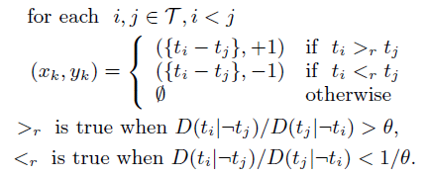

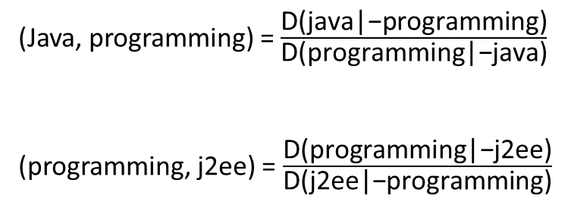


Learning-to-rank based tag ranking
Θ = 2
Tags (T)
Feature vector
(Java, programming) = $\frac{\text{D}\text{(}\text{java}\text{|−}\text{programming}\text{)}}{\text{D}\text{(}\text{programming}\text{|}\text{−}\text{java}\text{)}}$
(programming, j2ee) = $\frac{\text{D}\text{(}\text{programming}\text{|−}\text{j}\text{2}\text{ee}\text{)}}{\text{D}\text{(}\text{j}\text{2}\text{ee}\text{|−}\text{programming}\text{)}}$
-1
1. Java
2. Programming
3. j2ee
< 0.3 10 50 >
< 0.8 50 120 >
< 0.2 7 10>
$$\text{H}\text{(}\text{t}\text{) }$$
$$\text{D}\text{(}\text{t}\text{) }$$
$$\text{C}\text{(}\text{t}\text{)}$$
+1
(x₁,y₁) = ({-0.5, -40, -70}, -1)
(x₂,y₂) = ({0.6, 43, 110}, 1)

Slide 19
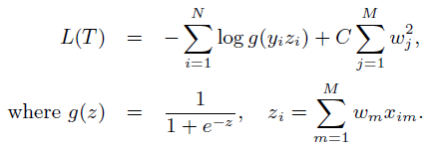
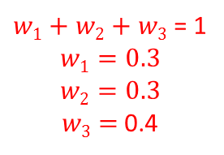
Learning-to-rank based tag ranking
3498 distinct tags ---> 532 training examples
N = 3
(Java, programming)
(java, j2ee)
(programming, j2ee)
(x₁,y₁) = ({-0.5, -40, -70}, -1)
(x₂,y₂) = ({0.1, 3, 40}, 0)
(x₃,y₃) = ({0.6, 43, 110}, 1)
$w1+w2+$ $w3$ = 1
$$w1=0.3$$
$$w2=0.3$$
$w3$ = 0.4
maximum L(T)
L(T) = ─ (log g( y₁ z₁ ) + log g( y₃ z₃ )) + ($C∗(\left(w1\right)2+\left(w2\right)2+\left(w3\right)2)$
-1
1
Z₁ = w₁ * (-0.5) + w₂ * (-40) + w₃ * (-70)
Z₃ = w₁ * (0.6) + w₂ * (43) + w₃ * (110)
57.08
-40.15
57.08
40.15
g(57.08) = 0.6
g(-40.15) = 0.2
g(57.08) = 0.6
g(40.15) = 0.4
z = -oo
z = oo
g(z)
0
1

Slide 20


Learning-to-rank based tag ranking
w1
Lr(tag)=
w2
X
$$\text{<}\text{H}\text{(}\text{t}\text{), }\text{D}\text{(}\text{t}\text{), }\text{C}\text{(}\text{t}\text{)>}$$
w3
= w₁ * H(tag) + w₂ * D(tag) + w₃ * C(tag)

Slide 21
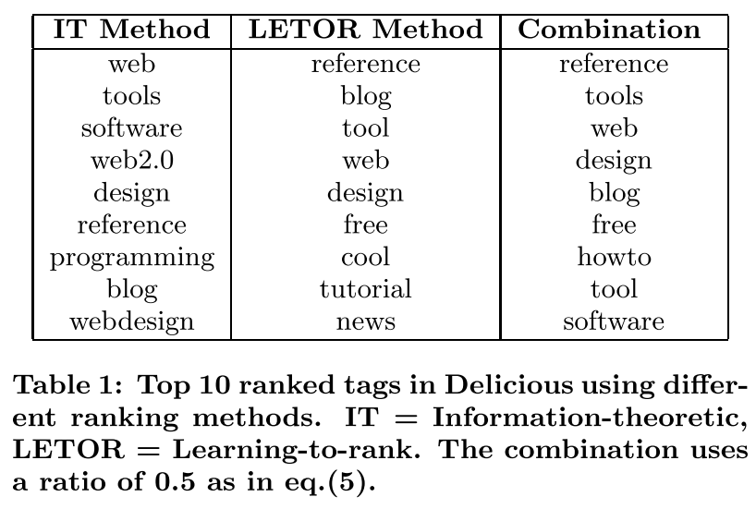
  Global tag ranking

Slide 22
  Constructing tag hierarchy
Goal
  select appropriate tags to be included in the tree
  choose the optimal position for those tags
Steps
  Tree initialization
  Iterative tag insertion
  Optimal position selection

Slide 23

Predefinition
R : tree
node
Root
programming
1
2
3
edge
(Java, programming)
{-0.5, -40, -70}
java
4
5
node

Slide 24

Predefinition
d(t_{i},t_{j}) : distance between two nodes
P(t_{i}, t_{j}) that connects them, through their lowest common ancestor LCA(t_{i}, t_{j})
Root
d(t₁,t₂)
LCA(t₁,t₂) = ROOT
0.3
P(t₁, t₂)
ROOT -> 1
ROOT -> 2
0.2
0.4
d(t₁,t₂) = 0.3 + 0.4 = 0.7
1
2
3
d(t₃,t₅)
LCA(t₃,t₅) = ROOT
0.1
0.3
P(t₃, t₅)
ROOT -> 3
ROOT -> 2, 2 -> 5
4
5
d(t₃,t₅) = 0.3 + 0.4 + 0.2 = 0.9

Slide 25

Predefinition
Root
0.3
0.2
0.4
1
2
3
0.1
0.3
Cost(R) = d(t₁,t₂) + d(t₁,t₃) + d(t₁,t₄) + d(t₁,t₅)
+d(t₂,t₃) + d(t₂,t₄) + d(t₂,t₅) + d(t₃,t₄)
+d(t₃,t₅) + d(t₄,t₅)
= (0.3+0.4) + (0.3+0.2) + 0.1 + (0.3+0.4+0.3)
+(0.4+0.2) + (0.3+0.1+0.4) + 0.3 + (0.3+0.1+0.2)
+(0.4+0.3+0.2) + (0.3+0.1+0.4+0.3)
= 6.6
4
5

Slide 26
Tree Initialization
Ranked list
Programming
News
Education
Economy
Sports
.
.
.
.
.
.
.
.
.
programming
news
sports
Top 1 to be root node?
education
.
.
.
.
.
.
.
.
.

Slide 27
Tree Initialization
Ranked list
Programming
News
Education
Economy
Sports
.
.
.
.
.
.
.
.
.
ROOT
programming
news
sports
education
.
.
.
.
.
.
.
.
.
.
.
.
27

Slide 28
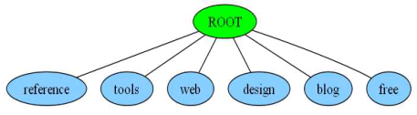


Tree Initialization
Child(ROOT) = {reference, tools, web, design, blog, free}
ROOT ---- reference = Max{W(reference,tools), W(reference,web),
W(reference,design), W(reference,blog),W(reference,free)}

Slide 29
Optimal position selection
Root
0.3
0.2
Ranked list
0.4
t₁
t₂
t₃
t₄
t₅
1
2
3
0.1
0.3
4
5
t6
if the tree has depth L(R), then t_{new} can only be inserted at level L(R) or L(R)+1
High cost

Slide 30
Optimal position selection
Cost(R) = d(t₁,t₂) + d(t₁,t₃) + d(t₁,t₄) + d(t₁,t₅)
+d(t₂,t₃) + d(t₂,t₄) + d(t₂,t₅) + d(t₃,t₄)
+d(t₃,t₅) + d(t₄,t₅)
= (0.3+0.4) + (0.3+0.2) + 0.1 + (0.3+0.4+0.3)
+(0.4+0.2) + (0.3+0.1+0.4) + 0.3 + (0.3+0.1+0.2)
+(0.4+0.3+0.2) + (0.3+0.1+0.4+0.3)
= 6.6
Root
0.3
0.2
0.4
1
2
3
0.1
0.3
Cost(R’) = 6.6 + d(t₁,t₆) + d(t₂,t₆) + d(t₃,t₆) + d(t₄,t₆) + d(t₅,t₆)
= 6.6+0.3+(0.4+0.6)+(0.2+0.6)+0.2+(0.7+0.6) = 10.2
0.2
4
5
Cost(R’) = 6.6 + d(t₁,t₆) + d(t₂,t₆) + d(t₃,t₆) + d(t₄,t₆) + d(t₅,t₆)
= 6.6+0.2+(0.4+0.5)+(0.2+0.5)+(0.1+0.2)+(0.7+0.6)
+(0.7+0.5) = 11.2
0.2
6
6
Cost(R’) = 6.6 + d(t₁,t₆) + d(t₂,t₆) + d(t₃,t₆) + d(t₄,t₆) + d(t₅,t₆)
= 6.6+(0.3+0.9)+0.5+(0.2+0.9)+(0.4+0.9)+0.2= 10.9
0.2
0.2
Cost(R’) = 6.6 + d(t₁,t₆) + d(t₂,t₆) + d(t₃,t₆) + d(t₄,t₆) + d(t₅,t₆)
= 6.6+(0.3+0.6)+0.2+(0.2+0.6)+(0.4+0.6)+(0.3+0.2)
= 10.0
6
6

Slide 31

Optimal position selection
Root
Cost(R) = d(t₁,t₂) + d(t₁,t₃) + d(t₁,t₄) +d(t₂,t₃) + d(t₂,t₄) + d(t₃,t₄)
Cost(R’) = d(t₁,t₂) + d(t₁,t₃) + d(t₁,t₄) +d(t₂,t₃) + d(t₂,t₄) + d(t₃,t₄)
+ d(t₁,t₄) + d(t₂,t₄) + d(t₃,t₄)
1
level
2
Consider both cost and the depth of tree
node counts
3
Root
5/log 5 = 7.14
2/log 5 = 2.85
1
2
3
4
4

Slide 32
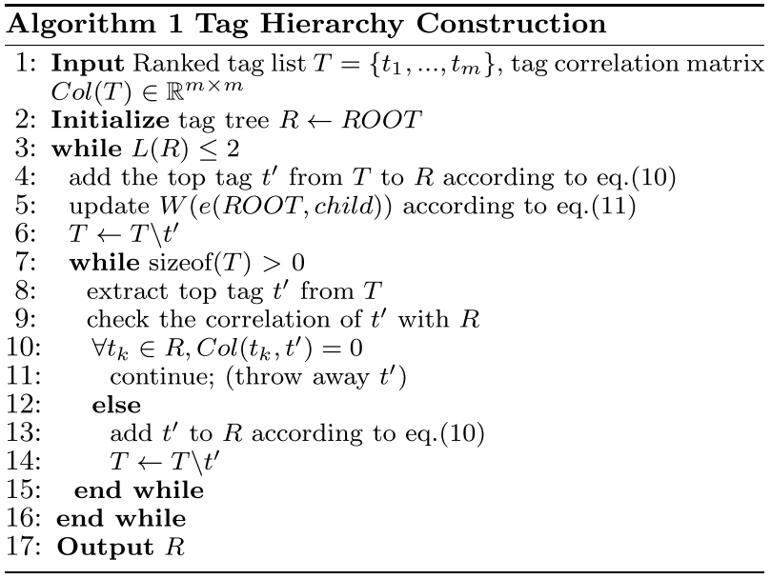
Ranked
list
tag correlation matrix
do
 | t1 | t2 | t3 | t4 | t5
t1 | 1 | 0 | 0 | 1 | 0
t2 |  | 1 | 0 | 0 | 1
t3 |  |  | 1 | 0 | 0
t4 |  |  |  | 1 | 0
t5 |  |  |  |  | 1
t₁
t₂
t₃
t₄
t₅
R
R
ROOT
ROOT
ROOT
t1
t2
t3
t1
t₂
t₃
t₄
t₅
t1
t2
t₃
t₅
t4
t5
t4
t4
t5

Slide 33
Applications to tag recommendation
doc
cost
doc
Similar
content
tags
Tag recommendation
doc
root
0.3
0.2
0.4
1
2
3
Tag recommendation
0.1
0.3
4
5

Slide 34
Tag recommendation
doc
root
0.3
0.2
0.4
1
2
3
0.1
0.3
4
5
User-entered tags
Candidate tag list
recommendation tags
One user-entered tag
Many user-entered tags
No user-entered tag

Slide 35
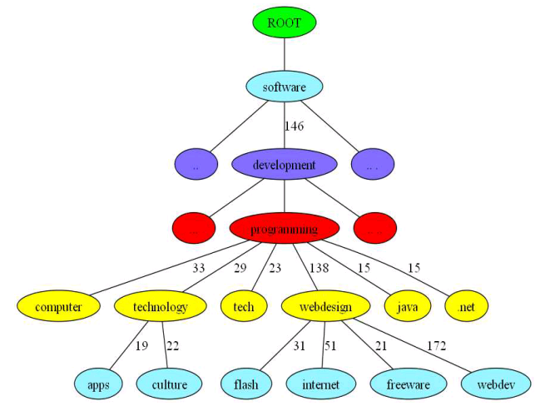
doc
programming
Candidate =
{Software, development, computer, technology, tech, webdesign, java, .net}
technology webdesign
Candidate =
{Software, development, programming, apps, culture, flash, internet, freeware}

Slide 36
doc
pseudo tags
Top k most frequent words from d appear in tag list

Slide 37
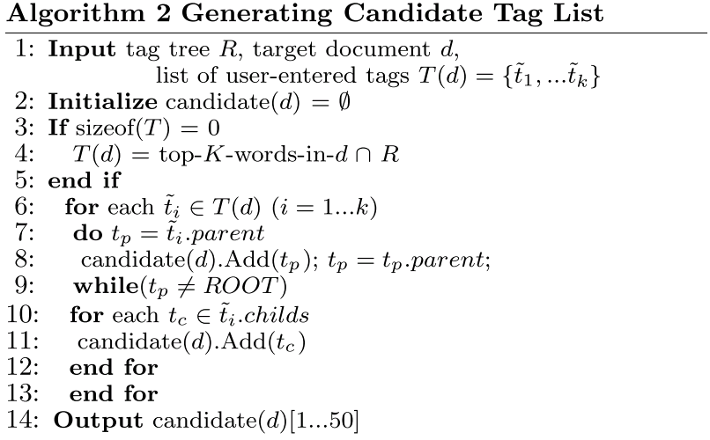
Tag recommendation

Slide 38

Tag recommendation
doc
technology webdesign
the number of times tag t_{i} appears in document d
Candidate =
{Software, development, programming, apps, culture, flash, internet, freeware}
Score(d, software | {technology, webdesign})
= α (W(technology, software) + W(webdesign, software) ) + (1-α) N(software,d)

Slide 39
Experiment
Data set
  Delicious
  43113 unique tags and 36157 distinct URLs
Efficiency of the tag hierarchy
Tag recommendation performance

Slide 40
Efficiency of tag hierarchy
Three time-related metric
  Time-to-first-selection
    The time between the times-tamp from showing the page, and the timestamp of the ﬁrst user tag selection
  Time-to-task-completion
    the time required to select all tags for the task
  Average-interval-between-selections
    the average time interval between adjacent selections of tags
Additional metric
  Deselection-count
    the number of times a user deselects a previously chosen tag and selects a more relevant one.

Slide 41
Efficiency of tag hierarchy
49 users
Tag 10 random web doc from delicious
15 tag were presented with each web doc
  User were asked for select 3 tags

Slide 43
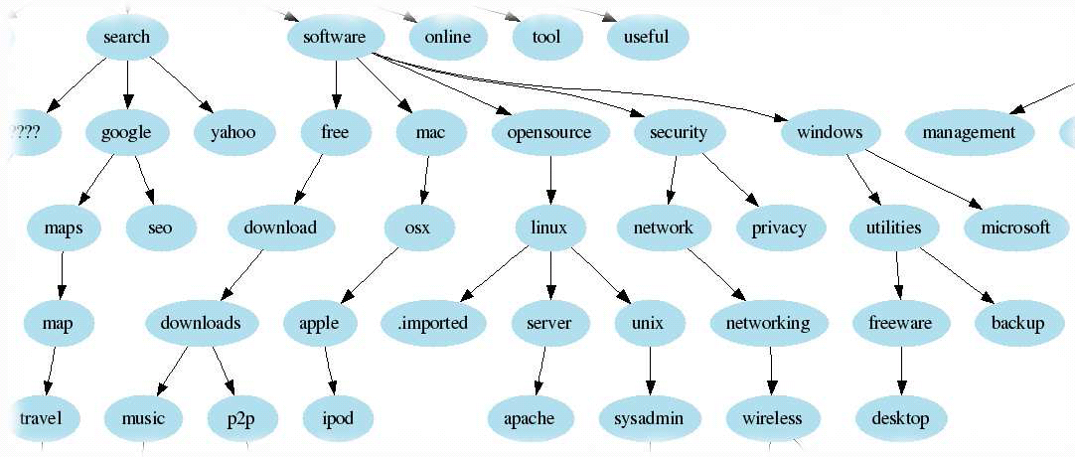
Heymann tree
A tag can be added as
  A child node of the most similar tag node
  A root node

Slide 44
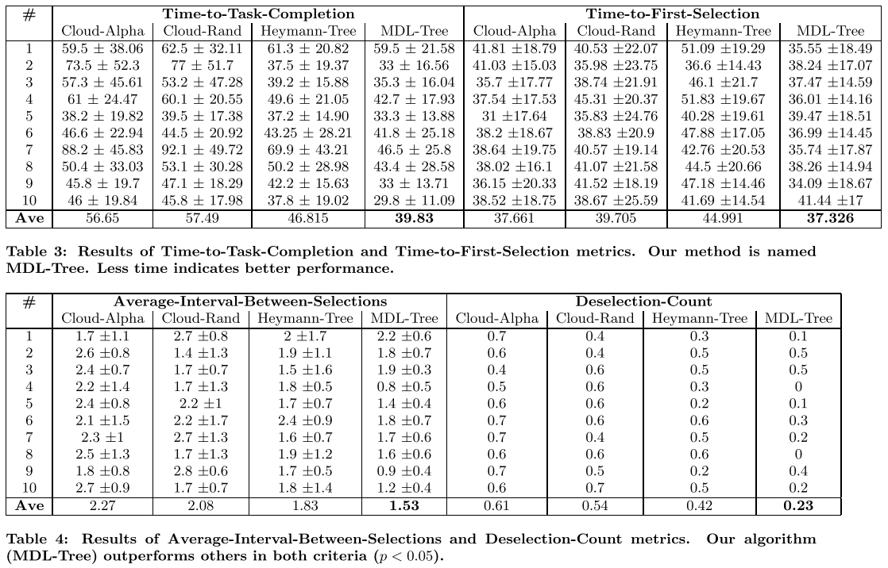
Efficiency of tag hierarchy

Slide 45
Tag recommendation performance
Baseline: CF algorithm
  Content-based
  Document-word matrix
  Cosine similarity
  Top 5 similar web pages, recommend top 5 popular tags
Our algorithm
  Content-free
PMM
  Combined spectral clustering and mixture models

Slide 46
Tag recommendation performance
Randomly sampled 10 pages
49 users measure the relevance of recommended tags(each page contains 5 tags)
  Perfect(score 5),Excellent(score 4),Good(score 3),Fair (score 2),Poor(score 1)
NDCG: normalized discounted cumulative gain
  Rank
  score

Slide 47


D1 D2 D3 D4 D5 D6
CG = 3 + 2 + 3 + 0 + 1 + 2 = 11
3, 2, 3, 0, 1, 2
i | rel_{i} | log₂(1+i) | 2^{rel} - 1
1 | 3 | 1 | 7
2 | 2 | 1.58 | 3
3 | 3 | 2 | 7
4 | 0 | 2.32 | 0
5 | 1 | 2.58 | 1
6 | 2 | 2.81 | 3
DCG = 7 + 1.9 + 3.5 + 0 + 0.39 + 1.07 = 13.86
IDCG: rel {3,3,2,2,1,0} = 7 + 4.43 + 1.5 + 1.29 + 0.39
= 14.61
NDCG = DCG / IDCG = 0.95
Each page has 5 recommended tags
49 users to judge
Average NDCG score

Slide 48
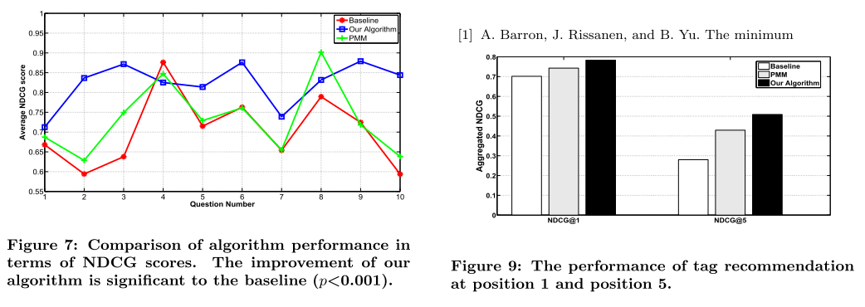

Slide 49
Conclusion
We proposed a novel visualization of tag hierarchy which addresses two shortcomings of traditional tag clouds:
  unable to capture the similarities between tags
  unable to organize tags into levels of abstractness
Our visualization method can reduce the tagging time
Our tag recommendation algorithm outperformed a content-based recommendation method in NDCG scores

